Slide 1
Advanced Topics in Networking
CSE 322

Slide 2
At A Glance …
An advanced execution
An advanced command
An advanced tool

Slide 3
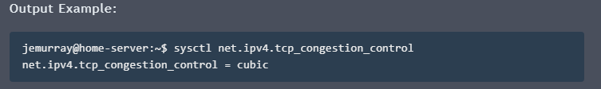
An Advanced Execution
TCP Congestion Control Algorithms (CCAs) in Linux
Source: https://jasonmurray.org/posts/2021/tcpcca/
Check the current CCA
sysctl net.ipv4.tcp_congestion_control

Slide 4
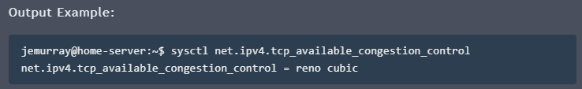
TCP CCA in Linux
Check for the default CCAs in Ubuntu
sysctl net.ipv4.tcp_available_congestion_control

Slide 5
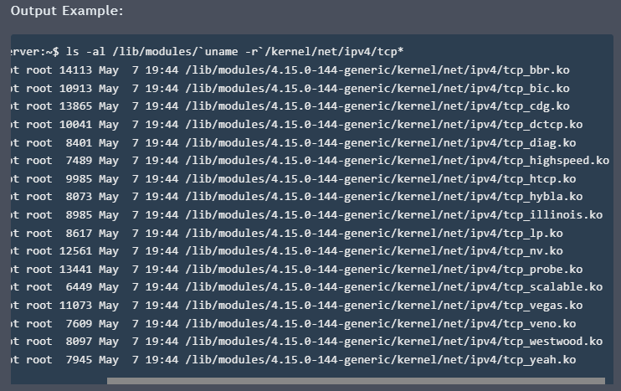
TCP CCA in Linux (contd.)
List installed, but not necessarily loaded CCAs
ls -al /lib/modules/`uname -r`/kernel/net/ipv4/tcp*

Slide 6
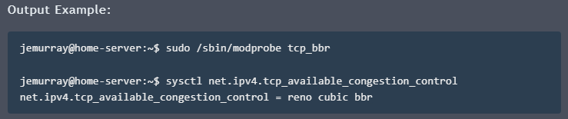
TCP CCA in Linux (contd.)
Use modprobe to load additional modules
sudo /sbin/modprobe tcp_bbr

Slide 7
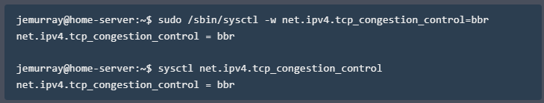
TCP CCA in Linux (contd.)
Use sysctl to temporarily change the CCA to bbr
sudo /sbin/sysctl –w net.ipv4.tcp_congestion_control=bbr

Slide 8
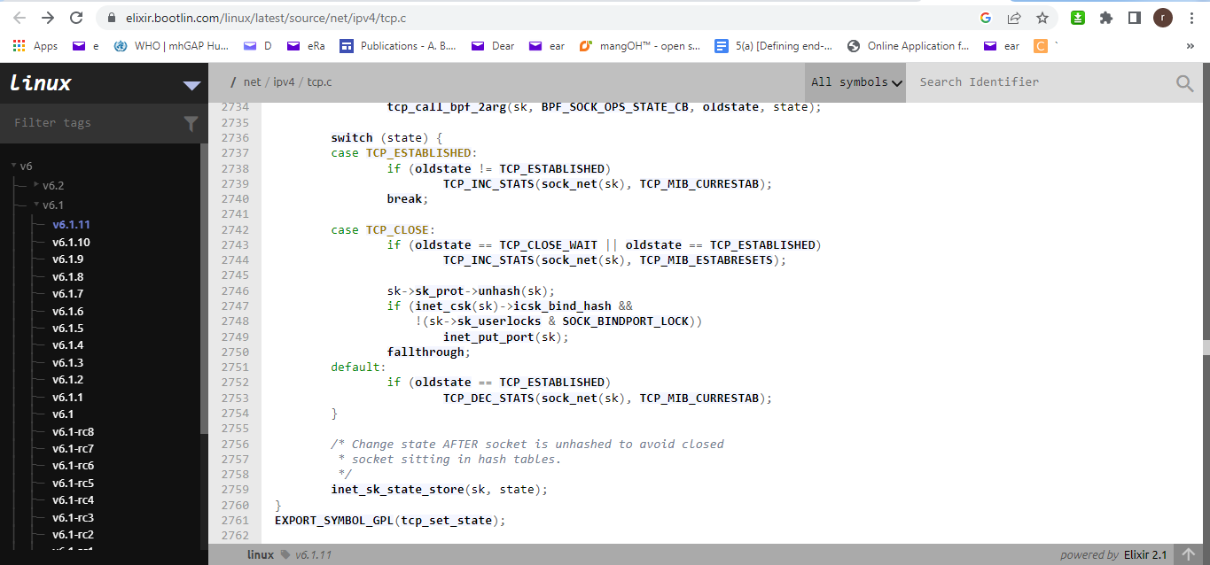
TCP Code in Ubuntu
Tentative location: /net/ipv4/tcp.c
A snapshot of a part of the code …

Slide 9
An Advanced Command
traceroute
Determines the route to a node
tracert: Windows
traceroute: Unix

Slide 10
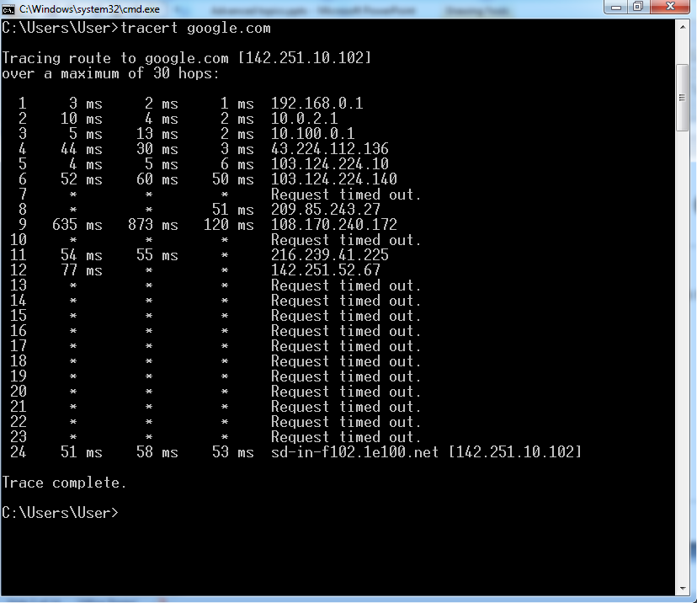
A Sample Output of “tracert”

Slide 11
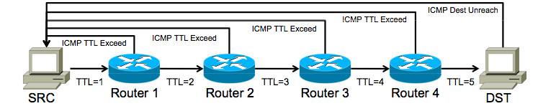
How Does Traceroute Work?
Launch a probe packet towards DST, with a TTL of 1
Every router hop decrements the IP TTL of the packet by 1
When the TTL hits 0, packet is dropped, router sends ICMP TTL Exceed packet to SRC with the original probe packet as payload
SRC receives this ICMP message, displays a traceroute “hop”
Repeat from step 1, with TTL incremented by 1 each time, until…
DST host receives probe, returns ICMP Dest Unreachable

Slide 12
Responses in Traceroute
All hops except the last one will (or should) return a "TTL exceeded in transit" message
The last hop should return a "destination unreachable/port unreachable" message indicating that it cannot handle the received traffic
UDP traceroute packets are typically addressed to a pseudorandom high port on which the end host is not likely to be listening

Slide 13
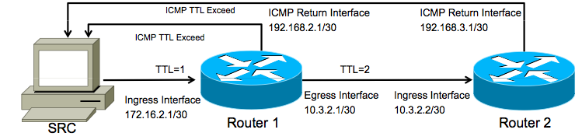
Traceroute Report Hop
Traceroute packet with TTL of 1 enters router via the ingress interface
Router decrements TTL to 0, drops packet, generates ICMP TTL Exceed
ICMP packet dst address is set to the original traceroute probe source (SRC)
ICMP packet src address is set to the IP of the ingress router interface
Traceroute shows a result based on the src address of the ICMP packet
The above traceroute will read: 172.16.2.1 10.3.2.2
You have NO visibility into the return path or the egress interface used

Slide 14
Traceroute Latency Calculation
How is traceroute latency calculated?
Timestamp when the probe packet is launched
Timestamp when the ICMP response is received
Calculate the difference to determine round-trip time
Routers along the path do not do anytime “processing”
They simply reflect the original packet’s data back to the SRC
Many implementations encode the original launch timestamp into the probe packet, to increase accuracy and reduce state
Most Importantly: only the ROUNDTRIP is measured
Traceroute is showing you the hops on the forward path
But showing you latency based on the forward PLUS reverse path
Any delays on the reverse path will affect your results

Slide 15

An Advanced Tool
Nmap
Source: https://nmap.org/download.html#windows
Extremely powerful
Extremely invasive
Extremely obvious if you are not careful
Extremely illegal if not done correctly

Slide 16
Port Scanning Basics
nmap scans more than 1660 ports
Most port scanners list ports as opened or closed
nmap recognizes 6 port states
Open
Accepting TCP connections or UDP packets
Closed
Host is up on the IP address
Accessible but no app is listening
Try later

Slide 17
Port Scanning Basics (contd.)
nmap recognizes 6 port states (contd.)
Filtered
No response from probe
Firewall probably did a stealth drop
Forces nmap to retry many times
Unfiltered
Port is accessible but cannot determine whether open or closed
Open|Filtered
When unable to determine whether port is open of filtered
Closed|Filtered
When unable to determine whether port is closed or filtered

Slide 18
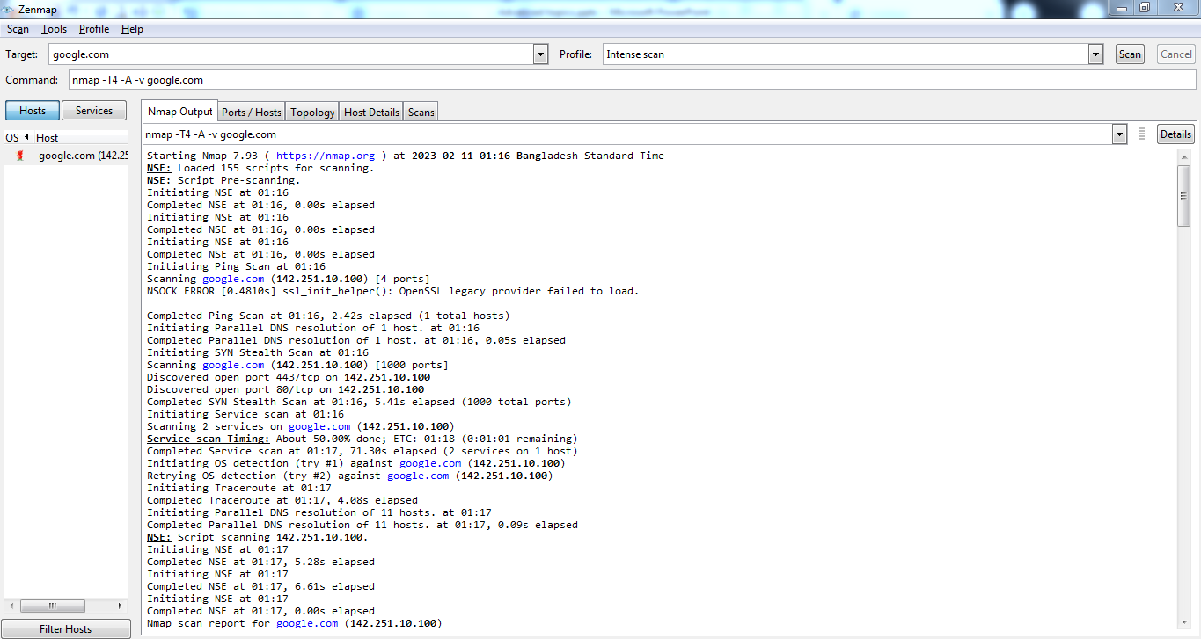
An Intense Scan in nmap: “Nmap Output”

Slide 19
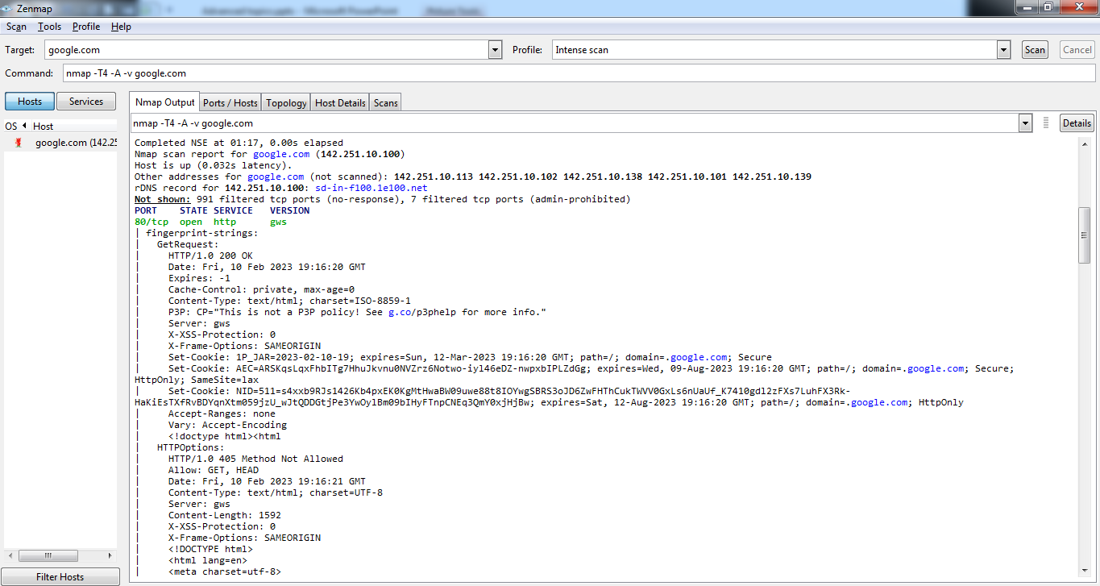
An Intense Scan in nmap : “Nmap Output” (contd.)

Slide 20
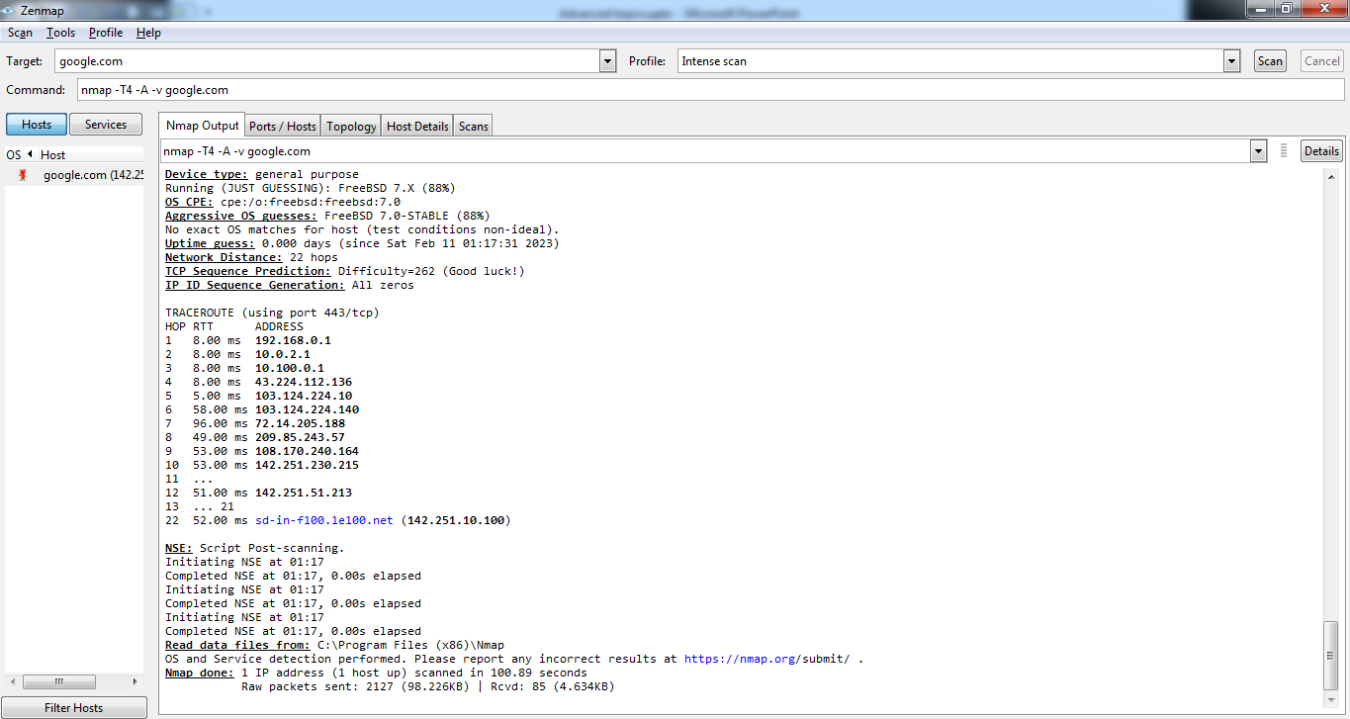
An Intense Scan in nmap : “Nmap Output” (contd.)

Slide 21
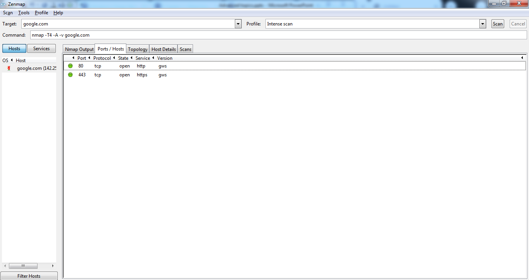
An Intense Scan in nmap: “Ports/Hosts”

Slide 22
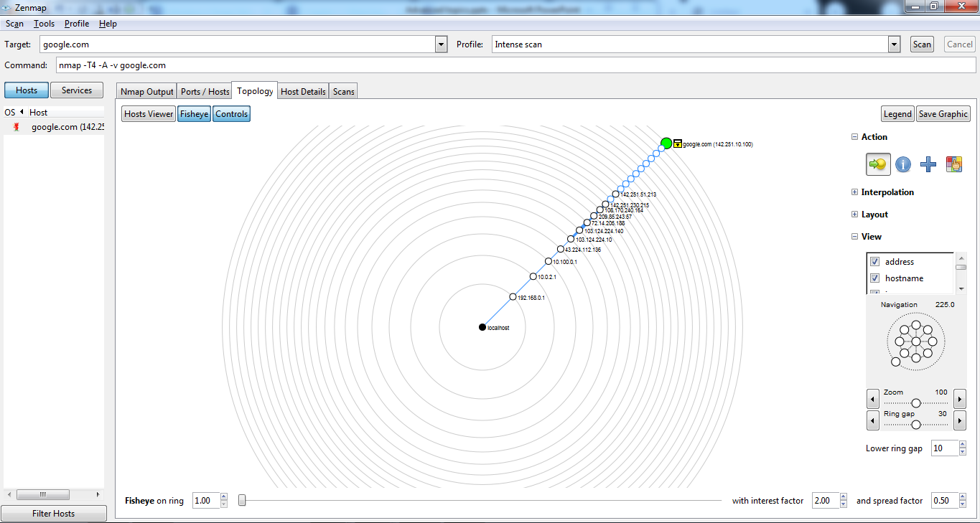
An Intense Scan in nmap: “Topology”

Slide 23
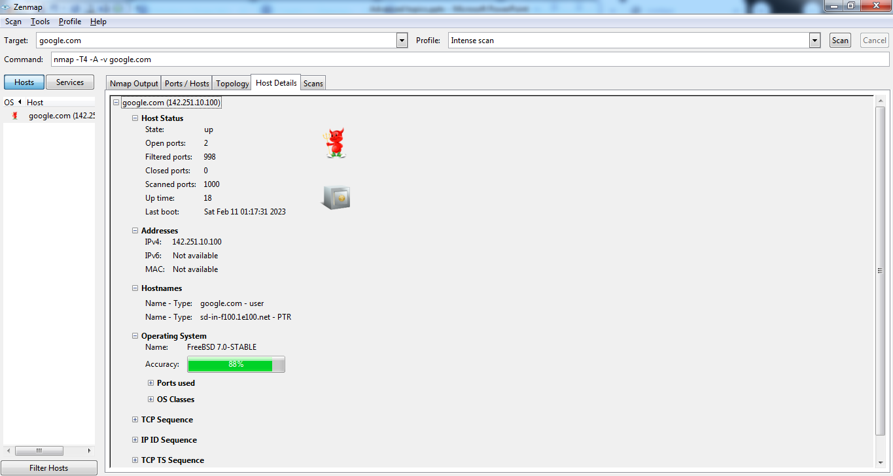
An Intense Scan in nmap: “Host Details”

Slide 24
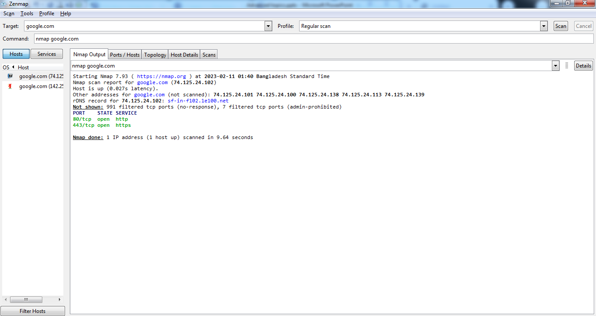
A Regular Scan in nmap: “Nmap Output”

Slide 25
Thank You

